Slide 1
What is Multiplexing?
Multiplexing is a technique used to combine and send multiple data streams over a single medium. The process of combining the data streams is known as multiplexing and the hardware used for multiplexing is known as a multiplexer.
Multiplexing is achieved by using a device called Multiplexer (MUX) that combines n input lines to generate a single output line. Multiplexing follows many-to-one, i.e., n input lines and one output line.
Demultiplexing is achieved by using a device called Demultiplexer (DEMUX) available at the receiving end. DEMUX separates a signal into its component signals (one input and n outputs). Therefore, we can say that demultiplexing follows the one-to-many approach.

Slide 2
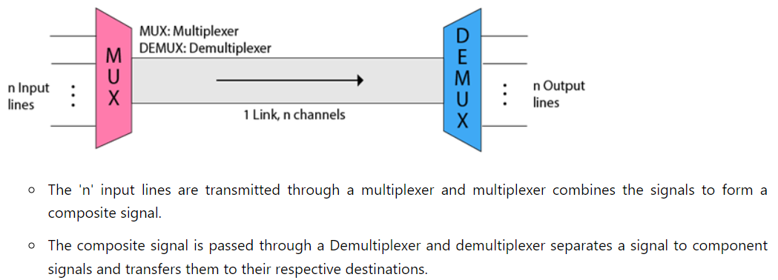
Why Multiplexing?
Concept of Multiplexing

Slide 3
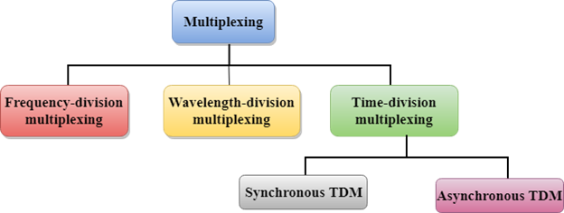
Multiplexing

Slide 4
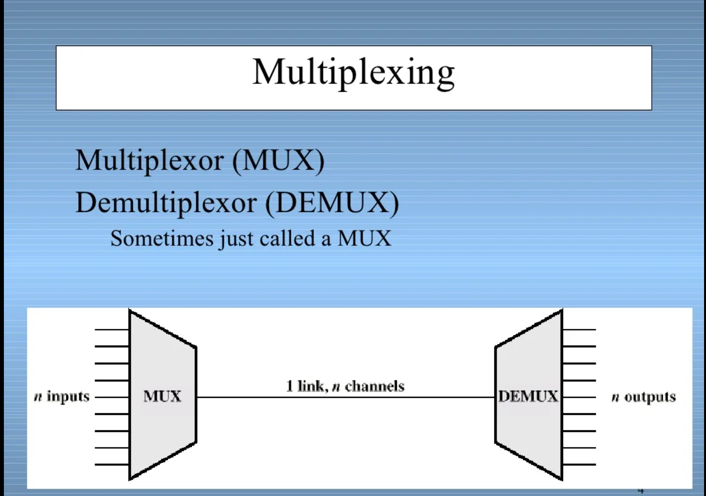
Why Multiplexing?

Slide 5
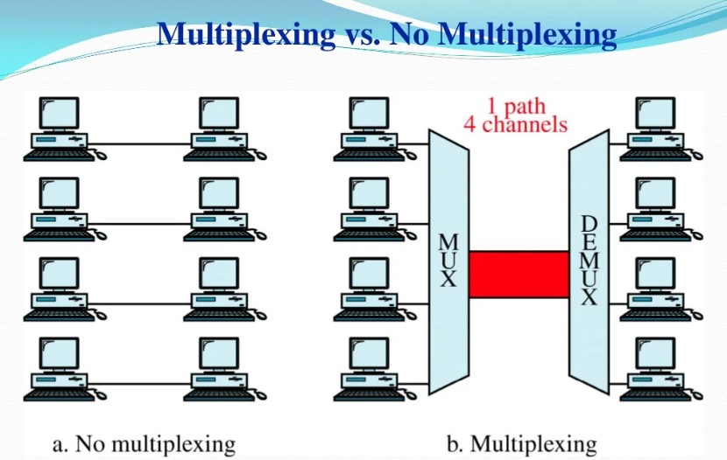

Slide 6
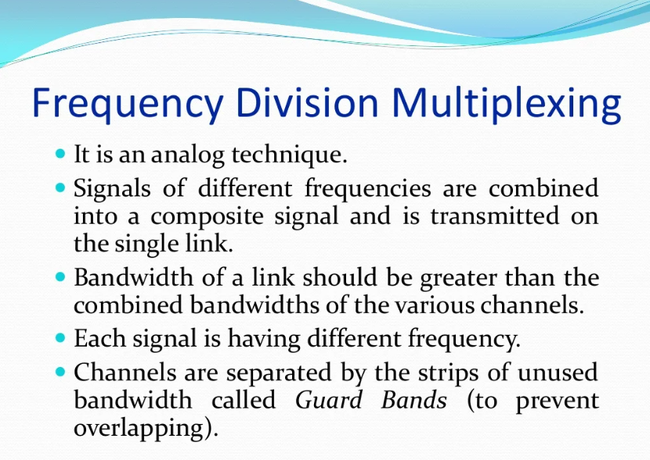

Slide 7
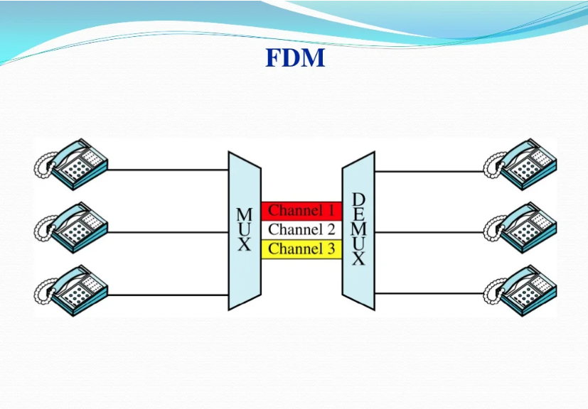

Slide 8
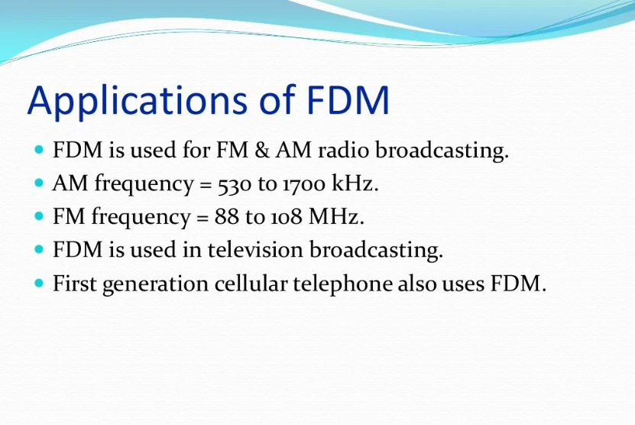
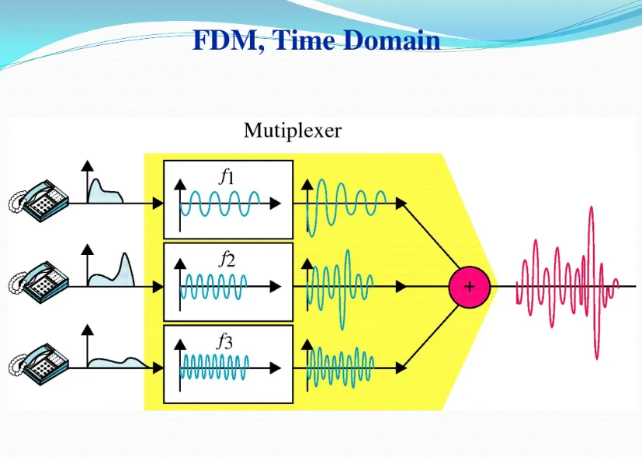

Slide 9
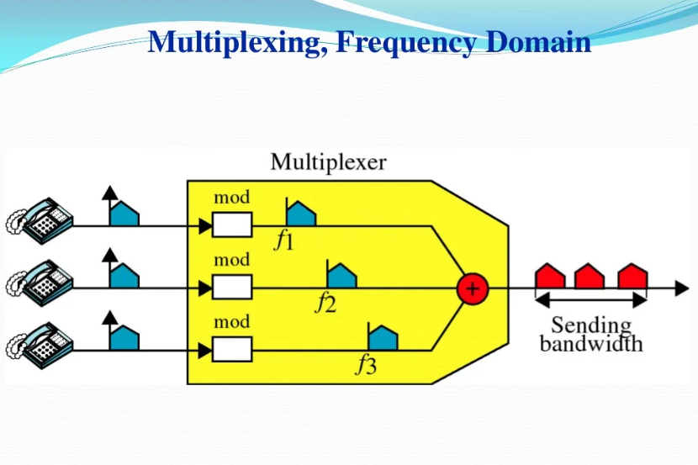

Slide 10
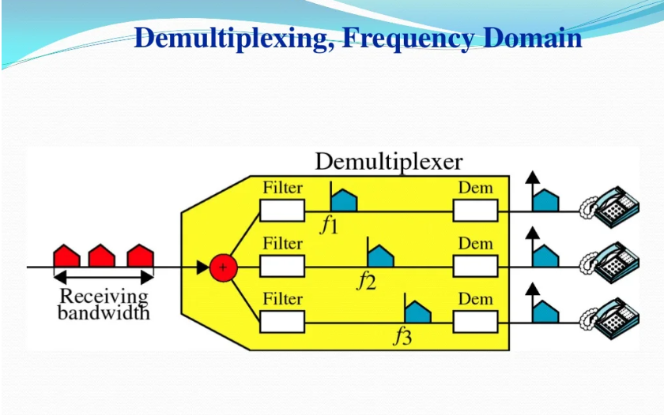

Slide 11
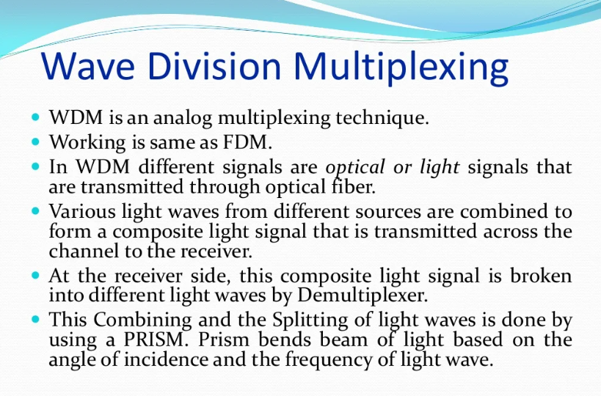

Slide 12
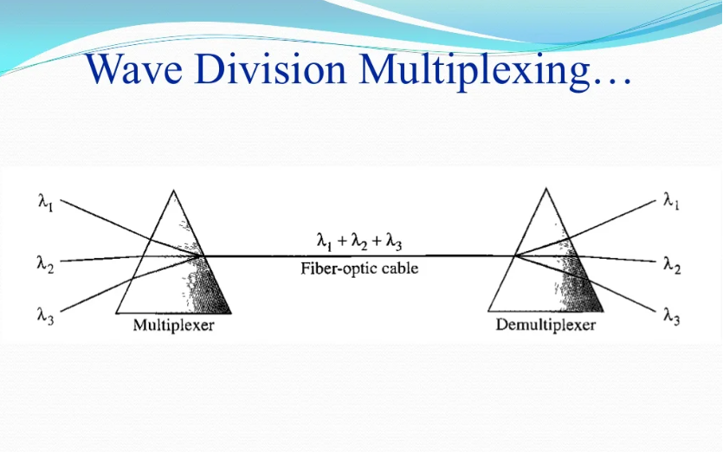

Slide 13
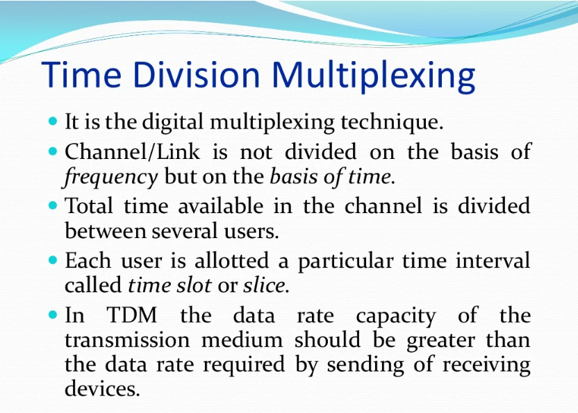

Slide 14
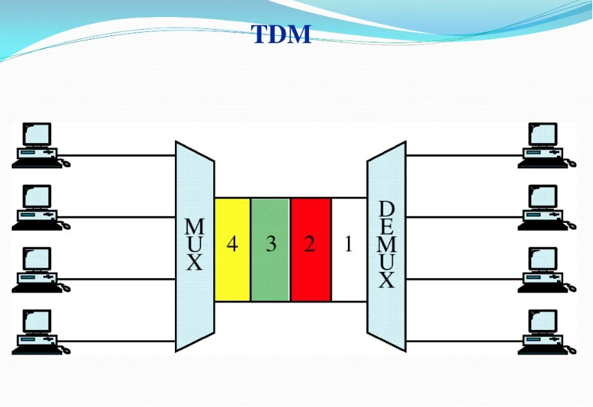

Slide 15
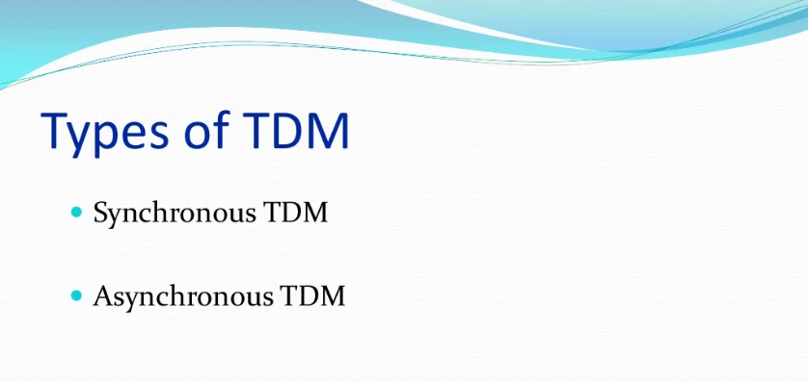

Slide 16
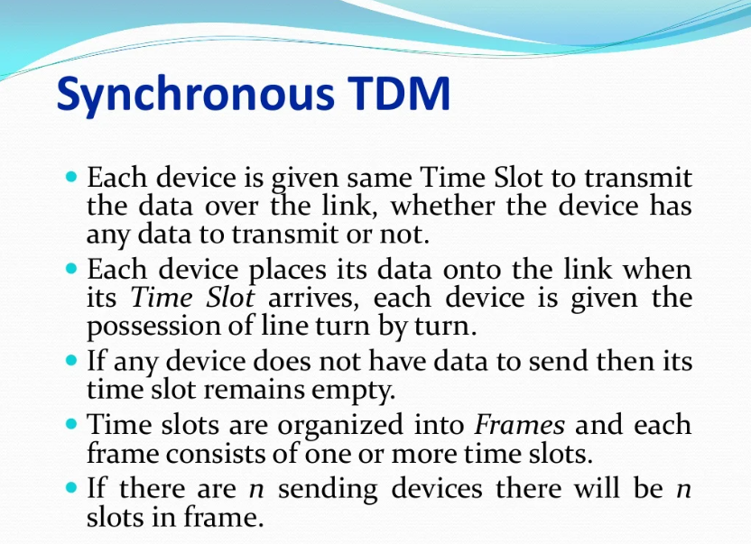

Slide 17
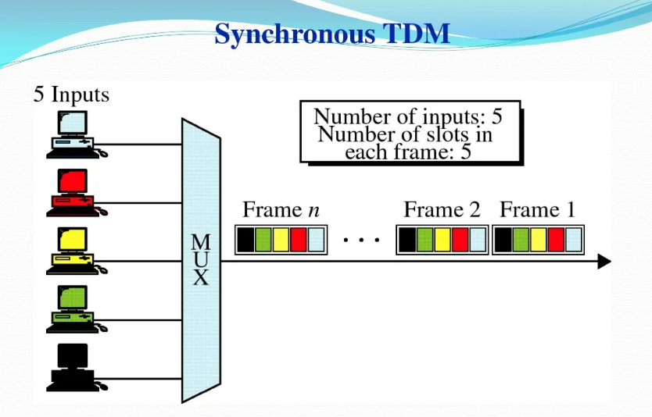

Slide 18
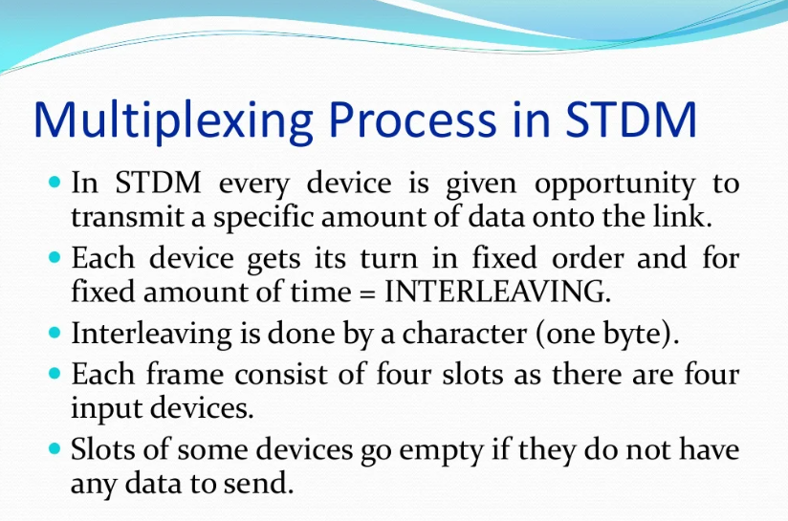

Slide 19
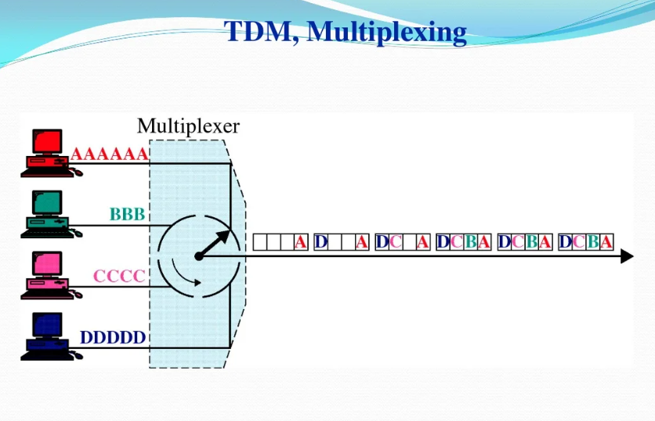

Slide 20
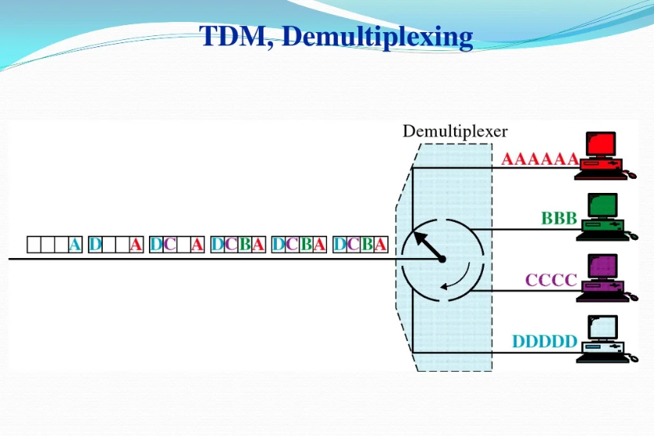

Slide 21
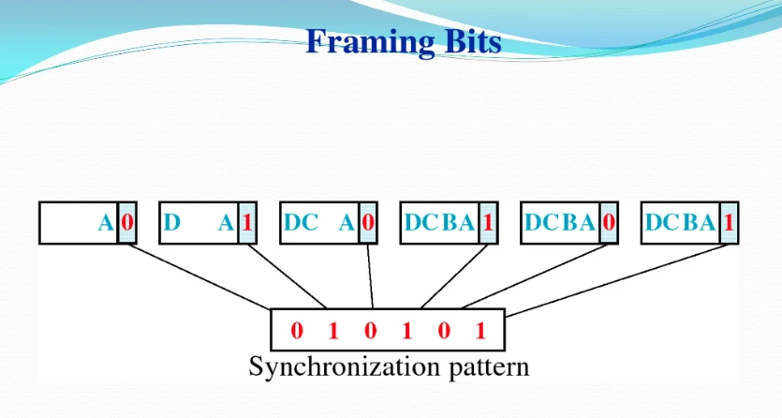

Slide 22
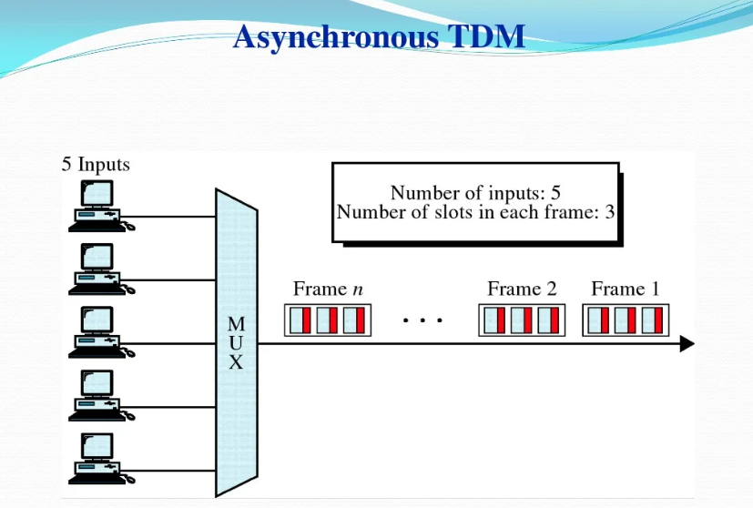

Slide 23
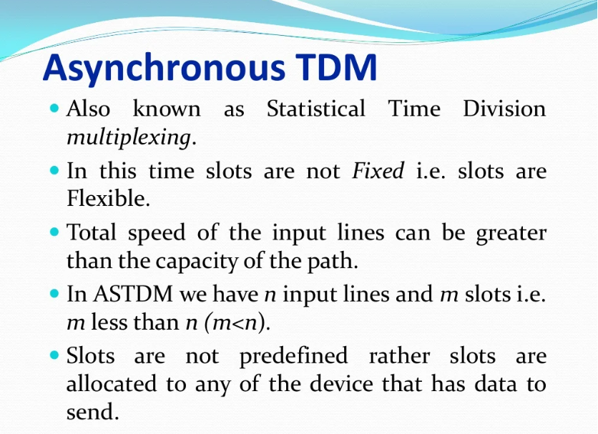

Slide 24
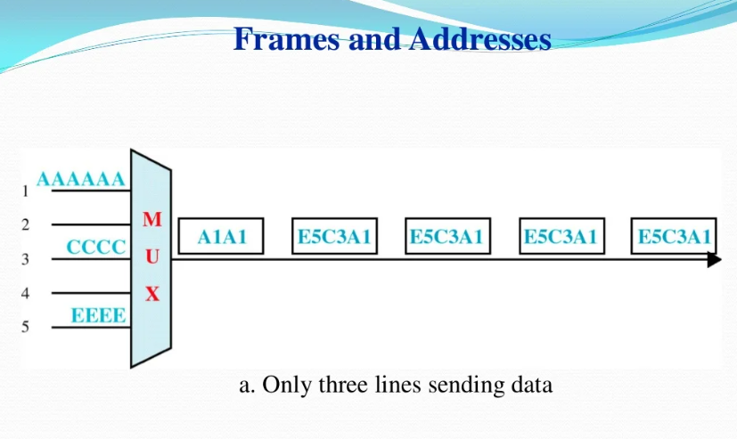

Slide 25
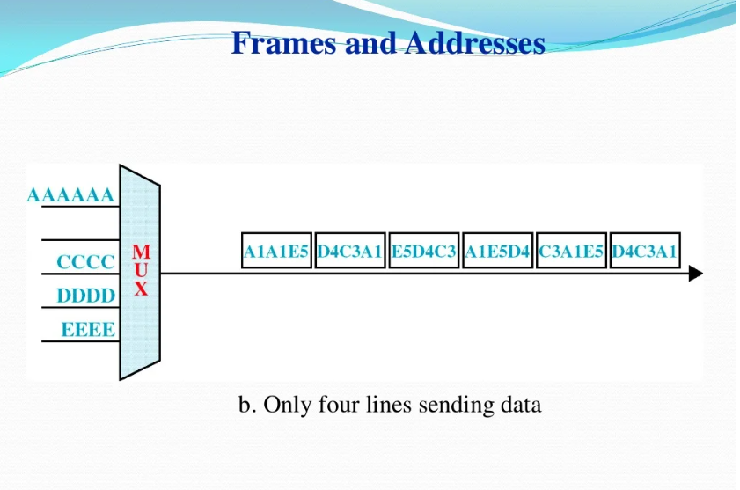

Slide 26
